Slide 1
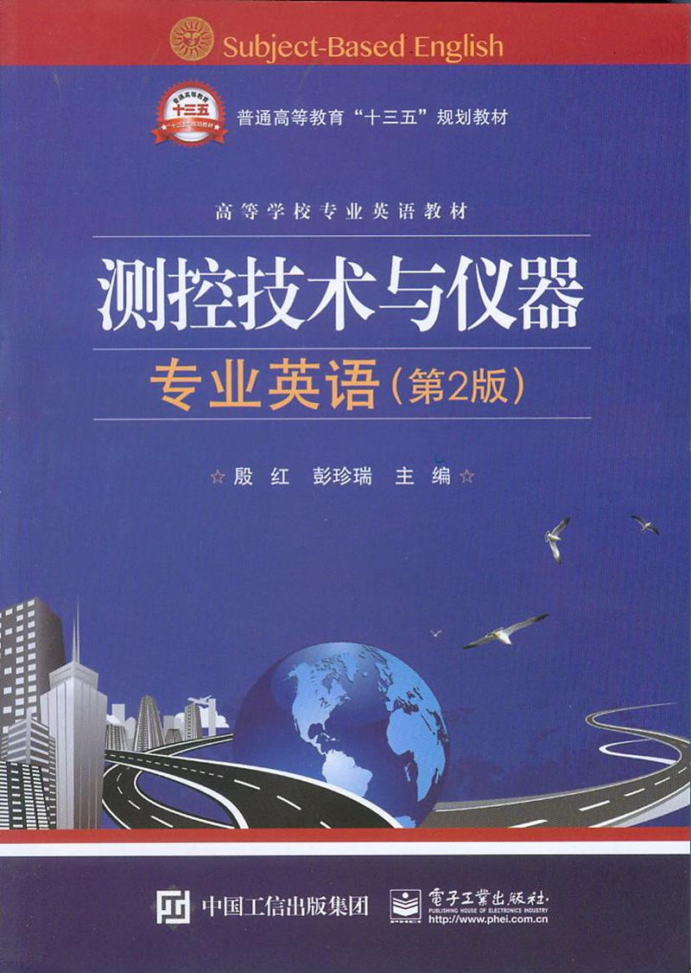
Unit10 Nature of Mechanical Design

Slide 2
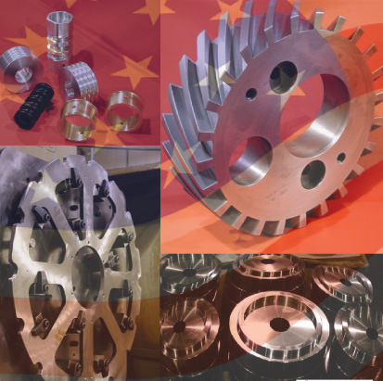
Unit10 Nature of Mechanical Design

Slide 3
It is essential that you know the desires and expectations of all customers before beginning product design. Marketing professionals are often employed to manage the definition of customer expectations, but designers will likely work with them as a part of a product development team.
在开始产品设计之前，知道用户的需求和期望是至关重要的。通常要雇用市场营销专家掌握用户的需求，但设计人员也可以作为产品开发团队的一部分，和他们一起工作。

Slide 4
Many methods are used to determine what the customer wants. One popular method, called quality function deployment (质量功能展开)or QFD, seeks to identify all of the features and performance factors that customers desire and to assess the relative importance of these factors. The result of the QFD process is a detailed set of functions and design requirements for the product.
确定用户需求的方法有很多。一个常用的方法，称为质量功能展开或QFD，力图确定用户需求的所有特点和性能因素，力图评估这些因素的相对重要性。QFD过程的结果是一套详细的产品功能需求和设计需求。

Slide 5
It is also important to consider how the design process fits with all functions that must happen to deliver a satisfactory product to the customer and to service the product throughout its life cycle.
句中to deliver和to service两个并列的动词不定式表达结构做happen的宾补。
译为：考虑好设计过程如何满足必需的全部功能，为用户提交一个满意的产品，并在产品的生命周期中便于维护，这也是非常重要的。

Slide 6
In fact, it is important to consider how the product will be disposed of after it has served its useful life. The total of all such functions that affect the product is sometimes called the product realization process (产品实现过程)or PRP.
事实上，考虑好产品服役期之后如何处理这些产品也是非常重要的。影响产品的所有这些功能有时称为产品实现过程或PRP.

Slide 7
Skills needed in mechanical design
Product engineers and mechanical designers use a wide range of skills and knowledge in their daily work, including the following:
产品工程师和机械设计师在他们的日常工作中运用大量的技巧和知识，包括：
（1）Sketching, technical drawing, and computer-aided design.
草图，技术制图，计算机辅助设计
（2）Properties of materials, materials processing, and manufacturing processes.
材料特性，材料加工，机械加工。

Slide 8
（3）Applications of chemistry such as corrosion protection (防腐，抗锈蚀) , plating(电镀) , and painting.
应用化工，比如防腐、电镀和上油漆。
（4）Statics, dynamics, strength of materials, kinematics, and mechanisms.
静力学、动力学、材料强度、运动学以及机构学。
（5）Oral communication, listening, technical writing, and teamwork skills.
口头沟通、听力、技术书写以及协作技巧。
（6）Fluid mechanics, thermodynamics, and heat transfer.
流体力学、热力学和传热学。

Slide 9
（7）Fluid power, the fundamentals of electrical phenomena, and industrial controls.
液压传动、电现象的基本原理以及工业控制。
（8）Experimental design and performance testing of materials and mechanical systems.
实验设计和材料性能测试以及机械系统。
（9）Creativity, problem solving, and project management.
创造力、解决问题以及工程管理。
（10）Stress analysis.
应力分析。

Slide 10
It is expected that you will have acquired a high level of competence in multi-disciplinary knowledge and skills that are developed continuously throughout your academic study and through experience.
随着多学科知识和技能的不断发展，要求你在学术研究和实践经验上都必须要有很高的能力水平。

Slide 11
Functions, design requirements, and evaluation criteria 功能、设计需求以及评价标准
In order to emphasize the importance of carefully identifying the needs and expectations of the customer prior to beginning the design of a mechanical device, you can formulate these by producing clear, complete statements of functions, design requirements, and evaluation criteria:
为了强调在开始机械装置设计之前仔细鉴别用户的需求和期望非常重要，你可以通过给出清楚完整的功能、设计需求和评价标准的陈述来进行规划。

Slide 12
Evaluation criteria should be developed by all members of a product development team to ensure that the interests of all concerned parties are considered. Often weights are assigned to the criteria to reflect their relative importance.
评价标准应由全体产品研发团队给出，以确保所有相关部门的利益都被考虑到。通常给标准赋予不同权重来反映其相对重要性。

Slide 13
Most designs progress through a cycle of activities as outlined in Figure 10.1. You should typically propose more than one possible alternative design concept. This is where creativity is exercised to produce truly novel designs.
大多设计过程的一个执行周期概述如图10.1所示。你一般要提出多个设计理念选项。运用创新性来创作真正的新型设计。

Slide 14
Then a rational decision analysis technique should use the evaluation criteria to decide which design concept is the optimum and, therefore, should be produced.
然后，合理的决策分析技术使用评估标准来决定哪个设计方案最优，然后，最终方案产生了。

Slide 15
Example of the integration of machine elements into a mechanical design
To illustrate how the design of machine elements must be integrated with a larger mechanical design, let us consider the design of a speed reducer (减速器)for the small tractor.
为了说明机械零件设计是如何与更大的机械设计集成的，让我们来考虑小型拖拉机减速器的设计。

Slide 16
Suppose that, to accomplish the speed reduction, you decide to design a double-reduction, spur gear speed reducer. You specify four gears, three shafts(轴), six bearing, and a housing to hold the individual elements in proper relation to each other.
假设，为了实现减速，你决定设计一个二级直齿轮减速器。你指定4个齿轮，3根轴，6个轴承和1个箱体，箱体使独立的零件保持适当的相互关系。

Slide 17
The design process as outlined here implies that the design can progress in sequence: from the gears to the shafts, to the bearings, to the keys (键) and couplings (联轴器), and finally to the housing.
这里概述的设计过程意味着：设计可按这样的顺序进行：从齿轮到轴，到轴承，到键和联轴器，最后到箱体。

Slide 18
It would be rare, however, to follow this logical path only once for a given design. Usually the designer must go back many times to adjust the design of certain components affected by changes in other components.
然而，对于给定的设计，很少沿着这个逻辑路线只进行一次。通常，设计者必须重复很多次来调整某个部件的设计，而这个部件因其他部件的改变而受到影响。

Slide 19
This process, called iteration(反复、重复、循环、迭代), continues until an acceptable overall design is achieved. Frequently prototypes(样机) are developed and tested during iteration.
这个过程叫迭代，这个过程一直重复直到得到一个满意的综合设计为止。在迭代期间，样机反复研发和测试。

